Slide 1
Career Development Training Course
Transitioning from the Navy

Slide 2
Enabling Objectives
STATE the purpose of Transition Assistance Program (TAP)
IDENTIFY the Military Life Cycles in regards to TAP
IDENTIFY the requirements of TAP
DESCRIBE Military Service Obligation (MSO) and 4-2-2 Military Service Obligation
STATE the purpose of the Navy Reserve
LIST the Navy Reserve categories
IDENTIFY the benefits of the Navy Reserve
IDENTIFY the Reserve Retirement requirements
DESCRIBE the functions of the Reserve Processing and Affiliation Center (RPAC)
IDENTIFY the role of the Command Career Counselor in the process to go Active Component to Reserve Component
Notes:
FACILITATOR GUIDE:
Review objectives.

Slide 3
References
Career Counselor Handbook, NAVPERS 15878 (series)
Navy Personnel Manual, NAVPERS 15560 (series)
Transition Assistance Program, OPNAVINST 1900.2D
Navy Enlisted Retention and Career Development Program, OPNAVINST 1040.11 (series)
The Mobilization Deferment Policy, ALNAVRESFOR 015/22
Navy Reserve Personnel Manual, RESPERSMAN M1001.5
Administrative Procedures for Navy Reservists, BUPERSINST 1001.39(series)
Website: https://www.mynavyhr.navy.mil/Career-Management/Transition/RPAC-Enlisted/
SELRES Tuition Assistance Pilot Program, NAVADMIN 075/24
Notes:
FACILITATOR GUIDE:
Review references.

Slide 4
Transition Assistance Program
Reference: Title 10 U.S.C., Sections 1142, 1143, 1144
DODI 1332.35
OPNAVINST 1900.2(series)
Purpose: TAP provides separating/retiring service members and their families with the skills, tools and self-confidence necessary to successfully re-enter into the civilian work force, pursue higher education, or technical training. The goal of the program is to provide professional career development resources throughout the military career life cycle (MLC) to best ensure success post Military Service.
Notes:
FACILITATOR GUIDE:
None

Slide 5
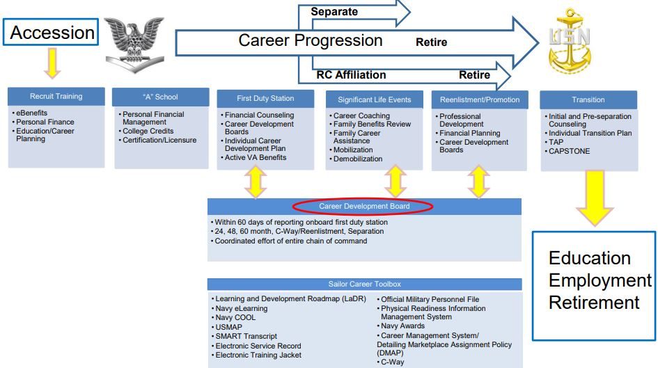
TAP Military Life Cycle
Notes:
FACILITATOR GUIDE:
None

Slide 6
Transition Assistance Program
All Sailors serving on Active Duty greater than 180 days are required to complete TAP requirements and meet Career Readiness Standards (CRS).
Five key components of TAP
  Mandatory initial counseling/self-assessment at least 365 days prior to separation
  Mandatory pre-separation counseling at least 365 days prior to separation
  Mandatory TAP core curriculum (3 Days of class provided by FFSC or TAP Online Courses via tapevents.mil/courses)
  Selection of two-day track (if not waived)
  Mandatory Capstone- Completed NLT 90 days prior to separation
CCC
Self-Assessment & Initial Counseling
Pre-Separation Counseling
DOD Transition Day
VA Benefits/
DOLEW Workshop
2-Day Career Track
CAPSTONE
Mandatory
Completed 365 days from separation
DAY 1
Mandatory
Completed 365 days from separation
DAY 2
Mandatory
My Transition
Military Occupational Code Crosswalk
Financial Planning
DAY 3
Mandatory
VA Benefits
Department of Labor Employment Workshop
DAY 4 & 5
• Employment Track
• Education Track
• Vocational Track
• Entrepreneurship Track
Must be completed no later than 90 days prior to separation
Notes:
FACILITATOR GUIDE:
Key Components are the items that will be met throughout the process. It starts with the Sailor completing the Self-Assessment and initiating their eForm on MILCONNECT. Once registered for TAP class, the components met will happen during their course of instruction. Once they are completed and have all CRS met and completed, they will schedule their Capstone to be completed NLT 90 days from their separation.
Note: Sailors are required to complete Capstone prior to taking terminal leave or commencing skillbridge.

Slide 7
Career Readiness Standards
Purpose: To evaluate service members preparedness to successfully transition from a military to civilian career and to validate the they have met appropriate CRS based on the goals they intend to pursue after active duty service.
Self-Assessment/Individual Transition Plan
Post-Transition Financial Plan
eBenefits registration
Continuum of Military Service brief (active duty only)
Gap Analysis or verification of employment
Completed Resume or provide verification of employment (based on track selection)
Comparison of Technical Instructions (based on track selection)
Comparison of College/Universities (based on track selection)
Notes:
FACILITATOR GUIDE:
Inform the audience that these are the CRS that Sailors must meet based on their desire post service goals. Some items can be waived and it will be based on their Tier and their Self-Assessment.

Slide 8
8 Year Military Service Obligation (MSO)
References: MILPERSMAN 1100-011
Personnel incur an 8 year MSO upon initial entry into any of the Armed Forces. This MSO can be accomplished by completing 8 years on active duty, inactive duty or a combination of both.
Sailors that meet or exceed 8 years on active duty can still affiliate with the reserves and may reenlist with a reserve contract upon affiliation.
MSO obligation is determined by the Initial Entry to Military Service (DIEMS). DIEMS can be found on the Sailor’s DD Form 4 in their OMPF.
  The Navy’s MSO for those who entered prior to 1 October 2020, is 4 years active with 4 years in the IRR.
    Member may elect to affiliate with the SELRES but otherwise they are automatically transferred to the IRR after EAOS.
Notes:
FACILITATOR GUIDE:
All contracts will specify that after a Member has completed their active duty contract they will serve in either the SELRES, IRR or combination of the two based on the needs of the Navy to satisfy their 8 year MSO requirement.
If Sailors feel like there is a discrepancy it is always best to reach out to PERS or C-Way to obtain additional guidance.

Slide 9
4-2-2 Military Service Obligation
References: NAVADMIN 303/23
MILPERSMAN 1306-1501
DIEMS on or after 1 October 2020, the new MSO requirement is 4-2-2.
  4 years active, 2 years MANDATORY SELRES obligation, 2 years IRR.
  Sailors that extend or reenlist past 6 years, will not be required to affiliate in the SELRES but may elect to.
  If a Sailor completes more than 4 years but less than 6 years, they will have that time adjusted. (i.e. Sailor is on active duty for 4.5 years, they will do 1.5 years in the SELRES and 2 years in the IRR).
  Career Waypoint will be utilized starting at 10 months prior to SEAOS and up to 4 months to their SEAOS.
  Sailor’s whose ratings are not available in the SELRES are not required to affiliate with the SELRES and may transfer into the IRR or request conversion to a rate within the SELRES they qualify for.
  **Sailors enlisted under a PACT contract do not fall under 4-2-2**
Notes:
FACILITATOR GUIDE:
Sailors who fall under this program should be made aware of this at their reporting CDB. Sailors who are PACT or under special contracts are not under the 4-2-2 MSO but should be reviewed to ensure proper counseling is conducted and deadlines are not missed.
Additional CCC Roles in this process:
CCCs must identify all their 4-2-2 Sailors by using the CWAY module under the “Sailor Browser” or the through the Career Information Management System (CIMS) ALPHA Roster report.
For 4-2-2 Sailors who are separating and have remaining Military Service Obligation (MSO), CCCs must manually update Sailors in the CWAY module application as “Intends to separate” once they enter their window (10 mo. prior to their SEAOS) in order for a SELRES application to be “Auto Created”.
Once the applications are auto created in the CWAY module, CCCs must “Submit” each application individually, failure to do so will cause the application for the Sailor to remain as un-submitted and subsequently carry over to the “Failure to Submit” report.

Slide 10
Individual Ready Reserve
Sailors transitioning into the IRR require to be counseled on their requirements prior to separation.
  NOTE: IRR Counseling requirements can be found in MILPERSMAN 1001-145.
Sailors in the IRR are:
  Not affiliated with a drilling unit.
  Not eligible for advancement.
  Required to maintain their physical fitness standards and medical readiness.
  Respond to official correspondence and complete their Annual Screening.
  Keep uniforms in serviceable condition.
Notes:
FACILITATOR GUIDE:
Members may enter the IRR for several reasons: SELRES receiving disability, HYT and other personal reasons.
Advised CDT to review MPM 1001-125.
CCC are responsible for counseling separating members utilizing NAVPERS 1070/613 and ensuring that NAVPERS 1070/613 is added to the separating service member’s OMPF.
3. IRR FAQs can be retrieved from the link below:
https://www.mynavyhr.navy.mil/Career-Management/Reserve-Personnel-Mgmt/IRR/IRR-FAQ/

Slide 11
Navy Reserve
The Navy Reserve prides itself on being the go-to force that provides valuable, vital support to all areas of the Navy. As individuals and as units, Navy Reserve Sailors serve side-by-side with their Active Duty counterparts in direct support of the Fleet – making the most of proven and potential abilities as they lead lives of pride, purpose and heroism on a mission that serves a greater cause.
The mission of the Navy Reserve is to provide strategic depth and deliver operational capabilities to the Navy and Marine Corps team and Joint Forces, in times of peace or war.
It comprises 20% of total Navy forces and is comprised of 3 categories.
Notes:
FACILITATOR GUIDE:
None.

Slide 12
Navy Reserve Categories
There are three categories within the Reserves they are: Ready Reserve, Standby Reserve and Retired Reserve.
  Ready Reserve includes Training and Administration of the Reserves (TAR), Selective Reserve (SELRES) and IRR.
  Members who drill for pay are in the SELRES.
  Members who do not receive pay are in the IRR.
  Members in the IRR are either in the Voluntary Training Unit (VTU) or Active Status Pool (ASP).
    VTU members are similar to Drilling Reservist but with two main differences. VTU personnel only drill for points towards retirement and do not receive pay. Some are eligible for advancement as long as they are not HYT.
    IRR members have annual muster and screening requirements until their MSO/contract time is completed and do not receive pay.
    Both are subject to recall back to active duty whether voluntary or involuntary.
  Personnel are moved into the Retired Reserve once they have met at least 20 years of qualifying service and are pending to reach retirement age for retirement pay. They are subject to recall in a time of war. This is often referred to Gray Area Retirees or Non-regular Retirement.
Notes:
FACILITATOR GUIDE:
TAR personnel are SELRES on active duty. They are in the same Branch Class as all other reservist the only difference is, they do not fall under the same retirement as the SELRES as long as they retire while on active duty.
SELRES not on active duty, drill for points towards their retirement by completing their drill weekend requirements and annual trainings. Additional ways to obtain points towards retirement are available and they would get more information on those opportunities upon affiliation.
VTU members are compromised of SELRES that recently received more than 30% disability from the VA or have hit HYT for their paygrade however do not have enough qualifying years towards retirement. Once they have met 20 qualifying years for retirement, they are to submit their request to retire and are moved into the Retired Reserve category.

Slide 13
Benefits of the SELRES
Flexibility to pursue Civilian College/Career Goals but remain in the Navy
Pay-SRBs
SGLI/FSGLI
Advancement
Uniform Replacement
Medical/Dental Coverage-TRICARE/TAMP
Education Benefits-CLEP/Dantes
Tuition assistance (Pilot Program)
Navy COOL
USERRA/SCRA
MGIB-SR eligibility (requires 6 year contract)
Post 9/11 GI Bill Transferability
Exchange/Commissary/MWR
FFSC
"Space A" air travel
Mobilization Deferment
Active Duty opportunities
Reserve Component Survivor Benefit Plan (RCSBP)
Reserve Retirement
BRS/TSP contributions
Notes:
FACILITATOR GUIDE:
Reserve Pay Charts can be found at Defense Finance and Accounting Service > MilitaryMembers > payentitlements > Pay Tables (dfas.mil).
Service members are eligible for the Servicemembers’ Group Lift Insurance (SGLI), but depending on type of status (non-paid drilling for points or paid), the member may be responsible for paying the SGLI premium. Refer to Defense Finance and Accounting Service > MilitaryMembers > paydeductions > sgli > resguardpremiums > navy (dfas.mil).
Education Opportunities can include, but are not limited to Navy COOL, DANTES, … etc.
Uniform Entitlements
If service member has not completed their MSO (Military Service Obligation (i.e. 8 years)), upon affiliating with the Selected Reserves, they will not receive an additional entitlement until MSO is complete.
If service member has completed their MSO, they will be eligible to receive a full sea bag in addition to free alterations.
Post 9/11 GI Bill Transferability – To be eligible to transfer the Post 9/11 GI Bill, the member will need to complete a minimum of 6 years and OBLISERVE for an additional 4 years (10 total years) and as long as the dependent is in DEERS, the service member can transfer the Post 9/11 GI Bill. Just be aware that if member is reenlisting for only 4 years (in order to transfer Post 9/11 GI Bill) that they only have 30 days immediately following reenlistment to sign Statement of Understanding and submit their application within MILCONNECT.
RCSBP is a program administered by the DOD that allows the service member to leave a percentage of your future Navy Reserve retired pay as a monthly survivor annuity to your beneficiaries. This will guarantee your survivors a share of your military pay after the service member has passed. Refer to MyNavyHR-Career Management- Reserve Personnel Management – Reserve Retirements – RCSBP for further eligibility and options.
Some of these benefits can have limitations and once the Sailor is affiliated in the Reserves, they can speak with their NRA for more information on what their full entitlements are. This can change at any time and it is best to advise them to review the Navy Reserve Homeport (link found in quick links on MNP) and review the Reserves Onboarding information.

Slide 14
Mobilization Deferment
Sailors transferring from Active Duty into the Selected Reserves qualify for a 2-year mobilization deferment
Deferment applies to all qualifying Sailors, regardless of active duty separation date
Sailors can choose to voluntarily mobilize at anytime.
Notes:
FACILITATOR GUIDE:
Deferment for mobilization is 24 months commencing on the Selected Reserve affiliation date. Best practice is to have your Sailor affiliate prior to getting off active duty via C-Way or 1306/7 request. This would also ensure they are not losing out on their TAMP benefits. Deferment policy does not apply to New Accession Trainees and Direct Commission Officers.
If Sailors do not affiliate prior to leaving active duty, they will lose out on TAMP benefits.
NOTE: Affiliation with the reserves with a break in service, will have the Sailors TIR recalculated for advancement purposes and possible ADSD adjustment IAW MILPERSMAN 100-030 and BUPERSINST 1430.16G.

Slide 15
Transitional Assistance Management Program (TAMP)
Provides 180 days of premium-free TRICARE transitional health care benefits after regular TRICARE benefits end.
Starts the day after you separate from Active Duty.
Not automatic, as individuals must meet one of the six qualifying criterion as described below:
  Involuntarily separate from active duty under honorable conditions;
  A reservist separated from active duty after serving more than 30 days in support of a contingency operations/COVID-19 response/preplanned mission;
  Separated from active duty following involuntary retention (stop-loss) in support of a contingency operation;
  Separate from military service following a voluntary agreement to remain on active duty for 1 year or less in support of a contingency operation;
  Receiving a sole survivorship discharge;
  Separated from active duty and agree to become a member (affiliate) of the Selected Reserve the day following the last day of active duty (if there is a gap, the member will not qualify for TAMP).
Notes:
FACILITATOR GUIDE:
During TAMP, the service member and their family members are eligible to use on of the following health plan options in addition to military hospitals and clinics:
- TRICARE Prime (where locally available)
- TRICARE Select
- US Family Health Plan (if you live in a designated location)
- TRICARE Prime Overseas
- TRICARE Selected Overseas
Other active duty programs such as the Extended Care Health Option (ECHO) are also available during the TAMP period.
-By transitioning via the RPAC, service members are more likely to avoid a break in active participation (i.e., Active Duty or SELRES) and become eligible for 6 months (180 days) of family Tricare benefits (same benefits enjoyed by Active Duty members). After the 6 months, service members can then enroll in Tricare Reserve Select for the remainder of their SELRES career. -Service members who qualify for Transitional Assistance Management Program (TAMP or TA-180), receive dental care under the Tricare Active Duty Dental Program for 6 months. After 6 months, service members may opt to receive coverage under the Tricare
Dental Program for Guard and Reserve service members. Eligible family members may purchase dental coverage separately.
During terminal leave, service members aren’t eligible for TAMP and should be covered under TRICARE Prime, TRICARE Prime Remote, or TRICARE Select.
All transition health care can be found below:
www.Tricare.mil/mybenefit

Slide 16
Non-Regular Retirement
Navy Reserve personnel can earn a Reserve retirement.
Must complete at least 20 qualifying years of service.
  Qualifying years is based off of the Sailor’s anniversary year and it is unique to each person. In order for that year to be qualifying towards retirement they must earn a minimum of 50 retirement points (not to exceed 365 per year) within their anniversary year.
  Retirement points are earned from the following:
    1 point for each day of active service
    1 point for each attendance at a drill period (drill weekend drill periods, additional IDT, annual training periods)
    1 point per day of funeral honors
    15 points for each year of membership in a reserve component
    Approved correspondence courses and processed with NRA
Retirement pay starts at age 60 or earlier depending on completed mobilization orders.
Retirement pay is based on points earned. More points = more retirement pay.
Eligible for TRICARE for Life.
Notes:
FACILITATOR GUIDE:
QUALIFYING YEARS of service will be explained in the following slide but there is a difference in satisfactory years of service in the reserves and qualifying years towards retirement. The last six years must be completed in the reserves. See BUPERSINST 1001.39F page 20-2 and 20-3 for more information.
The Sailor can review their anniversary by accessing their Annual Retirement Point Record and Annual Statement of Service (ARPR/ASOSH) via BOL.
SELRES are mobilization assets and are required to be at the ready in time of need. Their administrative requirements are keeping their employment, address, recall, dependency changes, Family Care Plan, medical status or anything that can affect their ability to mobilize current and ensure the NRA is aware of any changes or issues so that they can update their mobilization status correctly. They will be briefed on this upon affiliation and will sign a Satisfactory Participation Requirement Record. Ensure that these Sailors read the document prior to signing so that they are fully aware. For more information on this refer them to the Navy Reserve Homeport, RESPERMAN 1001-010 and BUPERSINST 1001.39F.

Slide 17
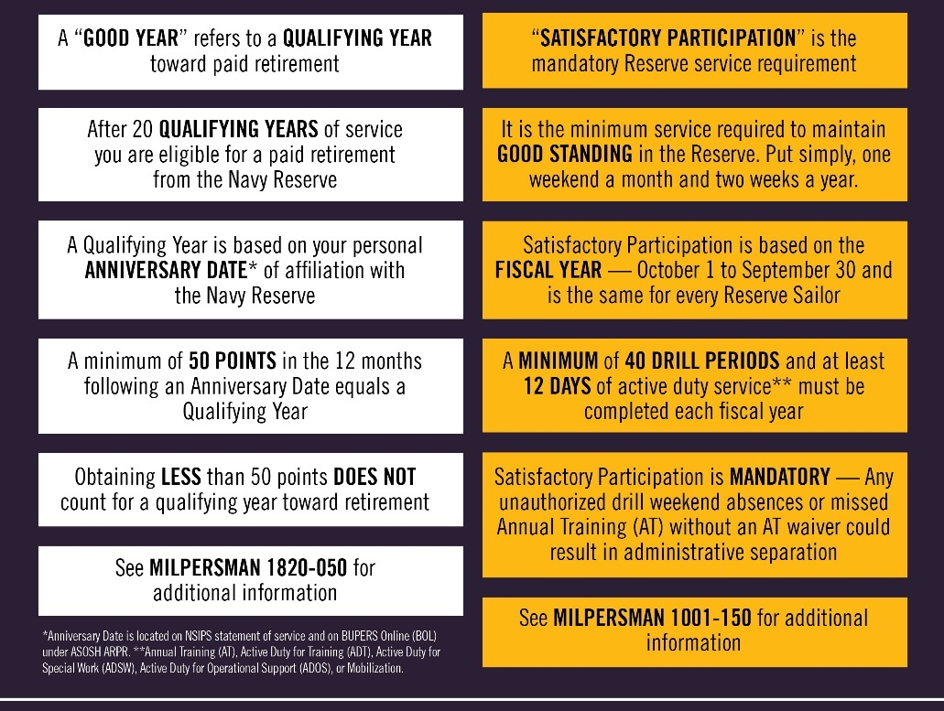
Qualifying Years vs
Satisfactory Participation
Notes:
FACILITATOR GUIDE:
I hope you find this table helpful in level-setting some foundational concepts for your Navy Reserve duties.
It is possible to earn a Qualifying Year while simultaneously having Unsatisfactory Participation.
It’s also possible to meet participation requirements within a Fiscal Year, but miss achieving a qualifying anniversary year toward retirement. You MUST manage both timeframes as you plan and execute your assigned duties.
A Sailor may have over 50 retirement points in an Anniversary Year, qualifying toward retirement, but have Unsatisfactory Participation.
Not completing an AT (and not having an approved AT waiver), or having more than nine unexcused drill period absences in the Fiscal Year OR a rolling twelve-month period yield. Unsatisfactory Participation, which could lead to administrative separation from the Navy Reserve.
“Unexcused absence from an annual training or from nine or more training units in a one year period often results in a discharge from the Reserve Component for failing to meet the training requirements.”
In other words, the member may have 50+ retirement points in an anniversary year, yielding a Qualifying Year, but have Unsatisfactory Participation due to no AT or >8 UAs, and may be ADSEP’d as a result.
Alternatively, a Sailor may take Authorized Absences or be approved for an AT Waiver within a Fiscal Year, yet fail to earn the requisite 50 Reserve Retirement Points within their unique Anniversary Year, missing eligibility.

Slide 18
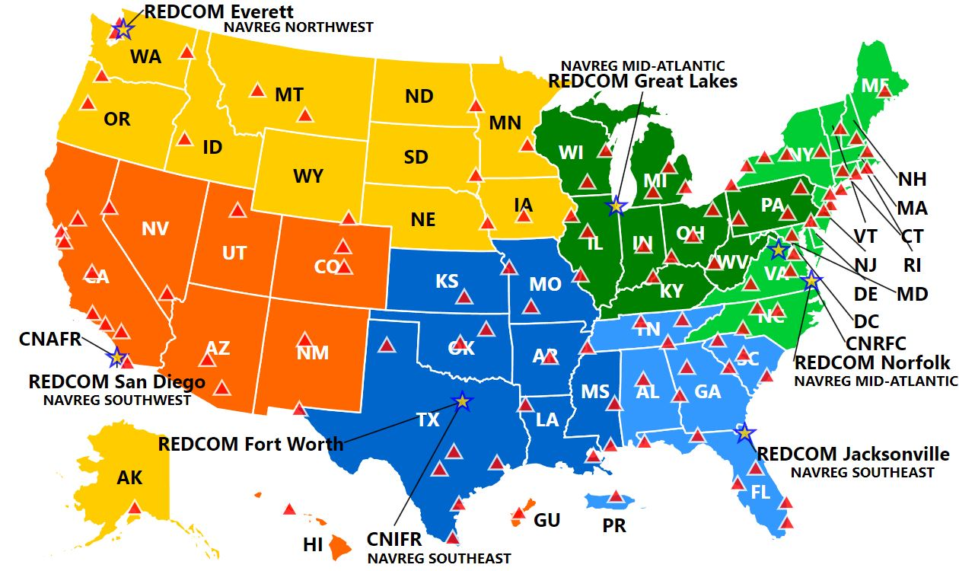
DRILLING LOCATIONS
Notes:
FACILITATOR GUIDE:
Where the Sailor is moving to is generally where the Reserve Center will be. There is at least one Reserve Center in each state- the RPAC TA will assign the best fit within that state.
All NRC command websites are hosted on the My Navy Reserve Homeport Website:
(CAC Required)
From the MYNRH main page, the Sailor can either search for the command in the search bar or navigate to the individual command via the “COMMAND” drop-down menu at the top of the page, followed by “REGIONS” to select the appropriate, and then the name of the NRC. Each NRC website provides a wealth of information specific to the command.
As part of your initial contact with the Navy Reserve Center staff, you will receive a Welcome Aboard Package that will provide basic information about the facility including:
• Facility address and entry instructions
• Command directory
• Drill Schedule
• Hours of operation
• Instructions for Meals and Berthing
• Holiday schedule
• Weather contingency plan
• Website address
NRC MAP: https://www.mynrh.navy.mil/#/map

Slide 19
Reserve Processing and Affiliation Center
From The Fleet To The Navy Reserve Center
The RPAC facilitates the transition of Active Duty/ Training and Administering the Reserves (TAR) enlisted service members to the Selected Reserves through:
Transition requests that are completed by the Sailor and CCC
The RPAC is a conduit between the Sailor and the Reserve Center to make the transition as smooth as possible.
Career Waypoints (C-WAY) or
NAVPERS 1306/7
Notes:
FACILITATOR GUIDE:
Not to be confused with the Career Transition Office. CWAY is the main way to complete the conversion. If Sailor is within 90 days of Separation without a CWAY quota they will use the route of submitting an EPAR with the Commanding Officer’s endorsement to the SELRES ECM.
https://www.mynavyhr.navy.mil/Career-Management/Community-Management/Enlisted/Selected-Reserves/

Slide 20
RPAC TRANSITION ASSISTANT
The TA will work directly with CCC’S & SAILORS:
They will help prepare and expedite documents
The TA will be the POC regarding Navy Reserve programs, policies, and transition:
Bonus Eligibility
24 Month Deployment Deferment
TAMP & Tricare Reserve Select
SGLI
Reserve Retirement and more
RPAC EMAIL:
rpac.enlisted.fct@navy.mil
OR CALL 901-874-4108
Notes:
FACILITATOR GUIDE:
Think of the Transition Assistant (TA) as the transition Sponsor for the Sailor.

Slide 21
Command Career Counselor Role for SELRES Affiliation
CAREER DEVELOPMENT BOARD (C-Way, Separation, MNA)
Discuss Reserve benefits for separating/undecided Sailors.
Update Career Intentions in CIMS, C-Way and MNA.
Submission of AC2RC Quota in CWAY
RPAC Transition Assistant (TA)
RPAC TA reaches out for documents to be submitted.
If Sailor does not have MSO time left, reenlistment contract is signed with RPAC TA.
Point of Contact that is working the case will reach out to the Sailor.
Notes:
FACILITATOR GUIDE:
1. Sailors will receive an email from their TA once an approval quota is issued. Sailors will work with their TA (kind of like a sponsor) to help with the transition and what paperwork will be needed from them.
2. The Reenlistment paperwork is part of the package the TA will need from the Sailor. So make sure to work hand-in-hand with the Sailor and the RPAC TA.

Slide 22
Knowledge Check
What are the Navy Reserve Categories?
Explain the 4-2-2 Military Service Obligation.
List five benefits of the SELRES.
If a Sailor joins the SELRES regardless of active duty
separation date, how long will their involuntary
mobilization deferment be?
Notes:
ANSWERS:
SELRES, IRR, RETIRED
Pay, SGLI, Advancement, Educational Opportunities, MGIB-SR, Uniform Entitlements, Medical/Dental Coverage-TRICARE, Exchange/Commissary/MWR, "Space A" air travel, Mobilization Deferment, Possible overseas opportunities, Reserve Component Survivor Benefit Plan (RCSBP), Retirement
2 years
ALNAVRESFOR 015/22
https://www.navyreserve.navy.mil/Portals/35/2022%20ALNAVRESFOR%20015%20MOBILIZATION%20DEFERMENT%20POLICY%20UPDATE%20FOR%20MEMBERS%20AFFILIATING.txt?ver=22QnlFTnGO-ln1hi49Ocqg%3d%3d

Slide 23
Summary and Review
In this lesson we discussed:
  The role of the Career Counselor regarding the Navy Reserves
  Purpose of the Navy Reserves
  Listed the Navy Reserve categories
  Benefits of the Navy Reserves
  The functions of the Reserve Processing and Affiliation Center (RPAC)

Slide 24

Navy Reserve

